Slide 1
DaTa Structures
INTRODUCTION
By
Dr. Zainab Malik

Slide 2
Content
Basic terminologies of data structure
Elementary data vs. group data
Data Structure
Introduction to different data structures
Basic Operation on different Data structures

Slide 3
Introduction
Data are simply values or set of values
{16, 17, 14, 10, 5}
A data item refers to a single unit of values e.g. 10
Data item can be of two types
Elementary Data: data items which cannot be divided into sub items /subordinates
e.g. Gender, Total items, Price, Year, Roll #
Group Data: data items which can be divided into sub items /subordinates
E.g. Name: First Name, Middle Name, Last Name
Date: Day, Month, Year
Address??

Slide 4
Data Management
These data values can be stored in main memory of the computer (RAM) or it can be permanently stored in secondary storage unit as files or tabular database.
This course covers the first case i.e. data storage in main memory

Slide 5
Data Structure
The logical or mathematical model of a particular organization of data is called data structure.
There are various data structures, each have their own properties
Arrays
Link Lists
Stack
Queue
Trees
Graphs etc.
The choice of particular data structures depends on two consideration
It must be rich in structure to reflect the true relationship of the data in the real world
The structure should be simple enough that one can effectively and efficiently process the data when required.
Notes:
A logical data model (LDM) is a type of data model that describes data elements in detail and is used to develop visual understandings of data entities, attributes, keys, and relationships.
Mathematical model: describe using mathematical concepts

Slide 6
Introduction to different data structures
Arrays (Linear Array): A set of similar types of data items
 | STUDENT
1 | Ayesha
2 | Suleman
3 | Sheraz
4 | Aimen
5 | Fatime
6 | Umair

Slide 7
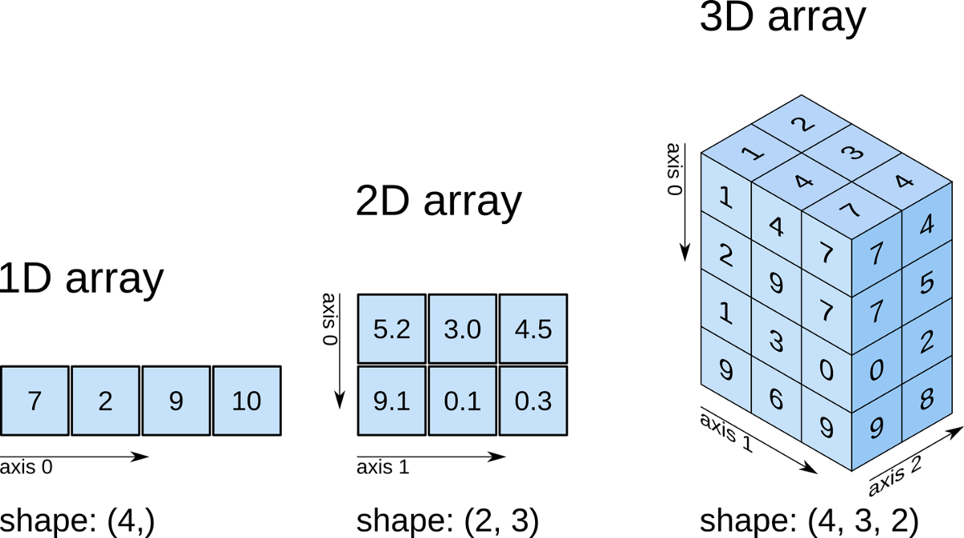
Introduction to different data structures (Cont…)
Arrays

Slide 8
Introduction to different data structures (Cont…)
Arrays (Multi-dimensional Array):
 | Stores
Department |  | s1 | s2 | s3 | s4
 | d1 | 2872 | 805 | 3211 | 1560
 | d2 | 2196 | 1123 | 4310 | 2111
 | d3 | 3000 | 2134 | 3365 | 1090
 | … | … | … | … | …
 | d28 | 2618 | 1500 | 3111 | 2189
Weekly sale of four different department in 28 different stores

Slide 9
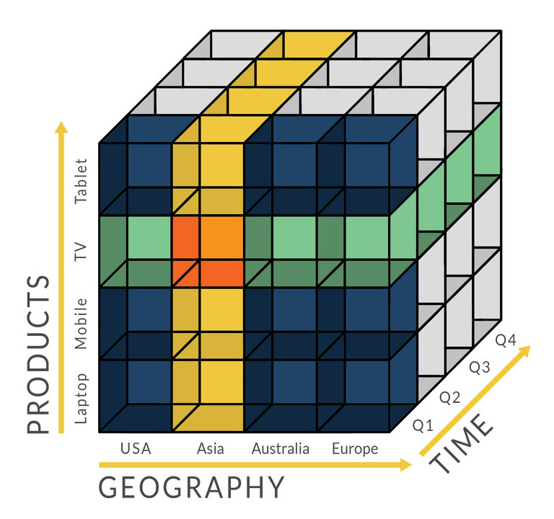
Introduction to different data structures (Cont…)
Arrays

Slide 10
Introduction to different data structures (Cont…)
Link List: Lets introduce it with an example of a company that maintains a file where each record contains a customer and his/her salesperson
 | Customers | Salesperson
1 | Ahmed | Suleman
2 | Bilal | Raheel
3 | Basit | Junaid
4 | Danish | Raheel
5 | Ehsan | Suleman
6 | Farhan | Junaid
7 | Ghazanfer | Raheel
8 | Haris | Suleman
9 | Ibrahim | Raheel
Repetition of data items so, its not an efficient way of storing this type of information

Slide 11
Introduction to different data structures (Cont…)
 | Customers | Salesperson
1 | Ahmed | 3
2 | Bilal | 2
3 | Basit | 1
4 | Danish | 2
5 | Ehsan | 3
6 | Farhan | 1
7 | Ghazanfer | 2
8 | Haris | 3
9 | Ibrahim | 2
Salesperson
Junaid | 1
Raheel | 2
Suleman | 3
Better representation because integer pointers require less space as compared to string data
If a company wants list of customers for a specific salesperson then how many rows needs to be checked? (ALL which is not efficient)

Slide 12
Introduction to different data structures (Cont…)
 | Customers
1 | Ahmed
2 | Bilal
3 | Basit
4 | Danish
5 | Ehsan
6 | Farhan
7 | Ghazanfer
8 | Haris
9 | Ibrahim
 | Salesperson | Pointer
1 | Junaid | 3,6
2 | Raheel | 2,4,7,9
3 | Suleman | 1,5,8
Searching is efficient now!
Problem: Each salesperson may have many pointers and the set of pointers will change as customers are added or deleted

Slide 13
Introduction to different data structures (Cont…)
Link List
 | Customers | Link
1 | Ahmed | 5
2 | Bilal | 4
3 | Basit | 6
4 | Danish | 7
5 | Ehsan | 8
6 | Farhan | 0
7 | Ghazanfer | 9
8 | Haris | 0
9 | Ibrahim | 0
Salesperson | Pointer
Junaid | 3 | 1
Raheel | 2 | 2
Suleman | 1 | 3

Slide 14

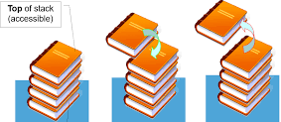
Introduction to different data structures (Cont…)
Stack: First In Last Out (FILO) or Last In First Out (LIFO)

Slide 15

Introduction to different data structures (Cont…)
Queue : First In First Out (FIFO) or Last In Last Out (LILO)

Slide 16
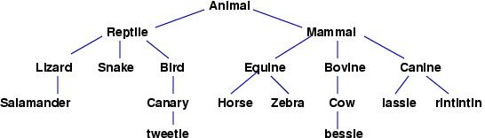
Introduction to different data structures (Cont…)
Trees
Animal
2. Reptile
3. Lizard
4. Salamander
3. Snake
3. Bird
4. Canary
5. Tweetle
2. Mammal
3. Equine
4. Horse
4. Zebra
3. Bovine
4. Cow
5. Bessle
3. Canine
4. Lassle
4. Rintintin

Slide 17
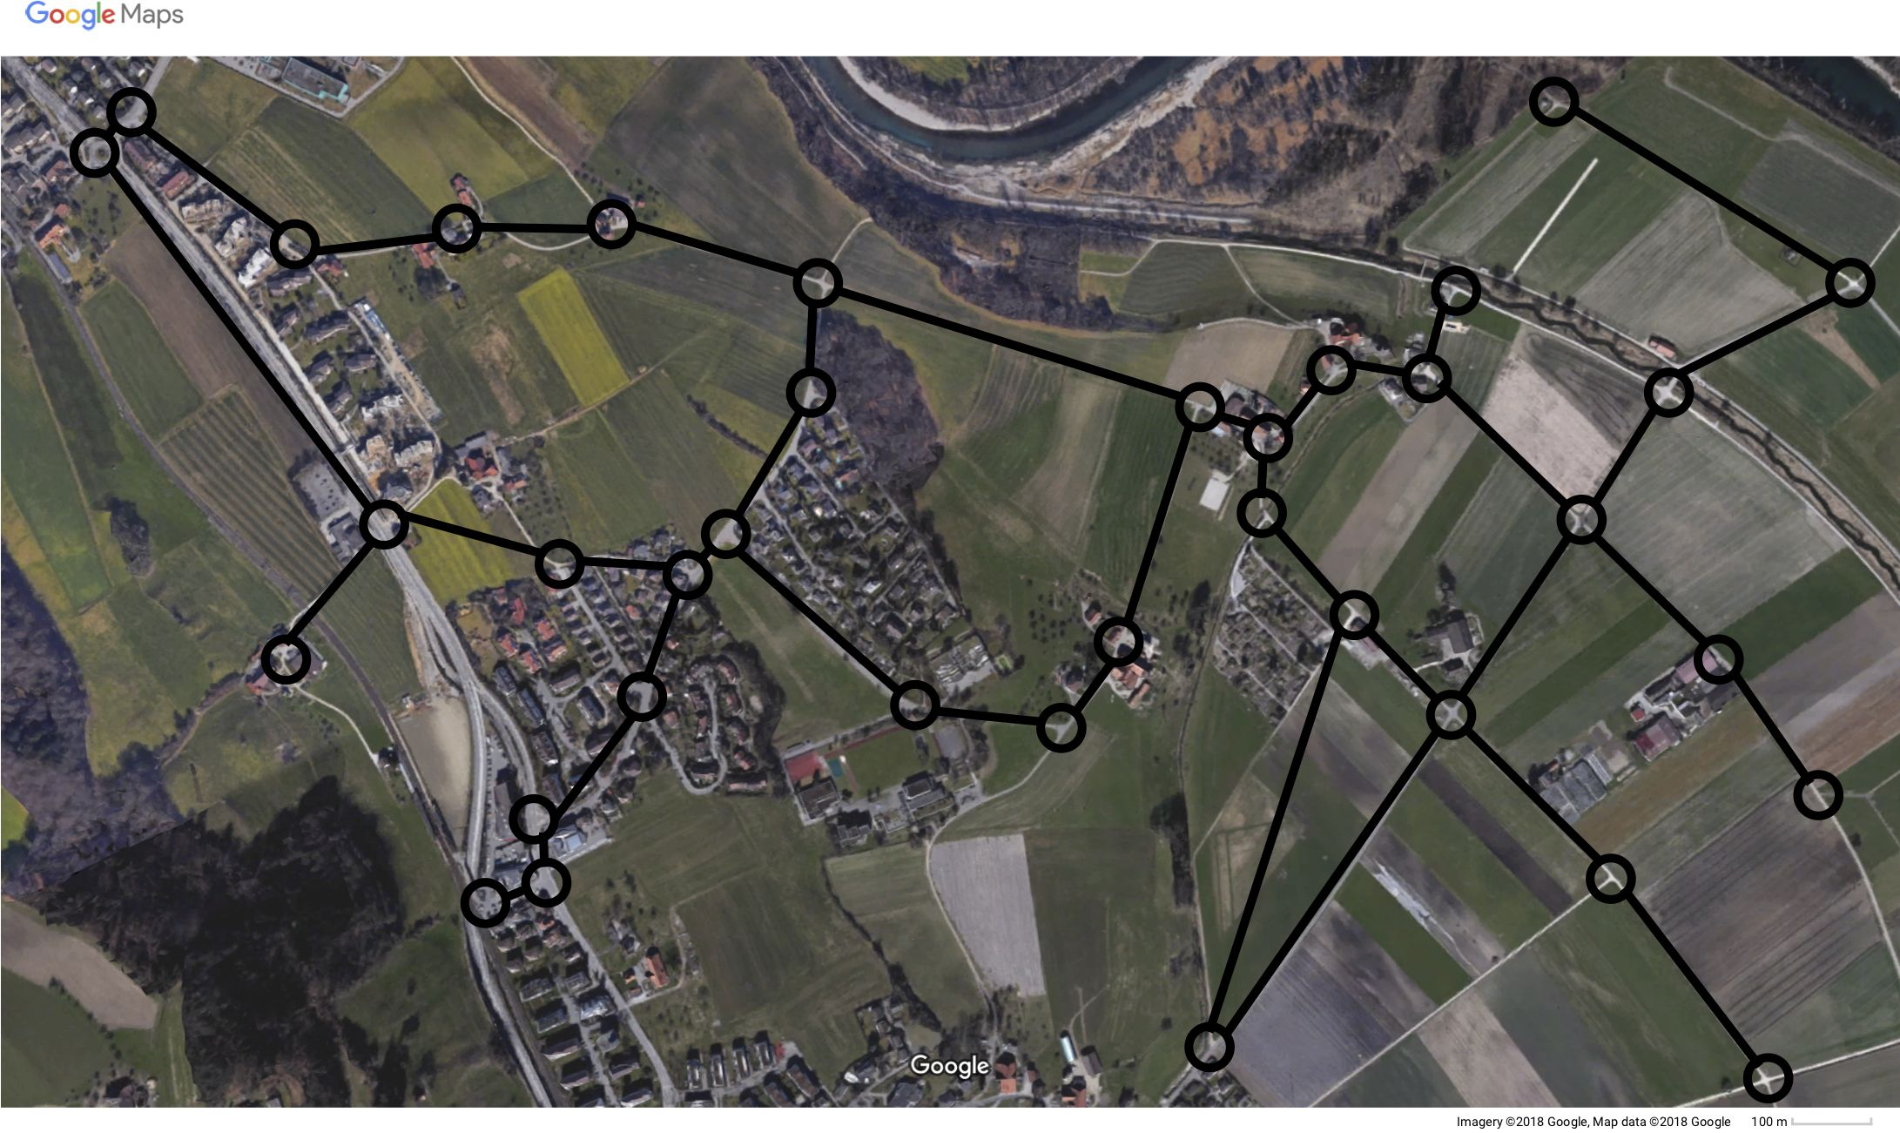
Introduction to different data structures (Cont…)
Graphs: Cycles are allowed.

Slide 18
Basic Operation
Traversing: To visit each data element once
Searching: To look for some data element
Insertion: To add an element
Deletion: To remove an element
Sorting: To arrange data in some order
Merging: To combine data elements of similar data structure.

Slide 19
Thank You

